Slide 1


Think Your Azure environment is Secure? Prove It! Start 10:10
Jimmy Bandell

Slide 2
Partners met toegang
Firewall
OT netwerk
Thuis kantoor
Cloud services
IoT apparaat
SaaS apps
Apparaat van bedrijf
Partners
Klanten
Apparaat van Partner
Identities
On-premises
API Koppeling
Thuiswerk medewerkers
Persoonlijk apparaat

Slide 3


Slide 4

Setting the Scene
1000’s of FTE
YoY growth of the company
Silos, departments, divisions
Spectacular growth in Azure

Slide 5


Jimmy
Bandell
Product Manager Public Cloud

Slide 6
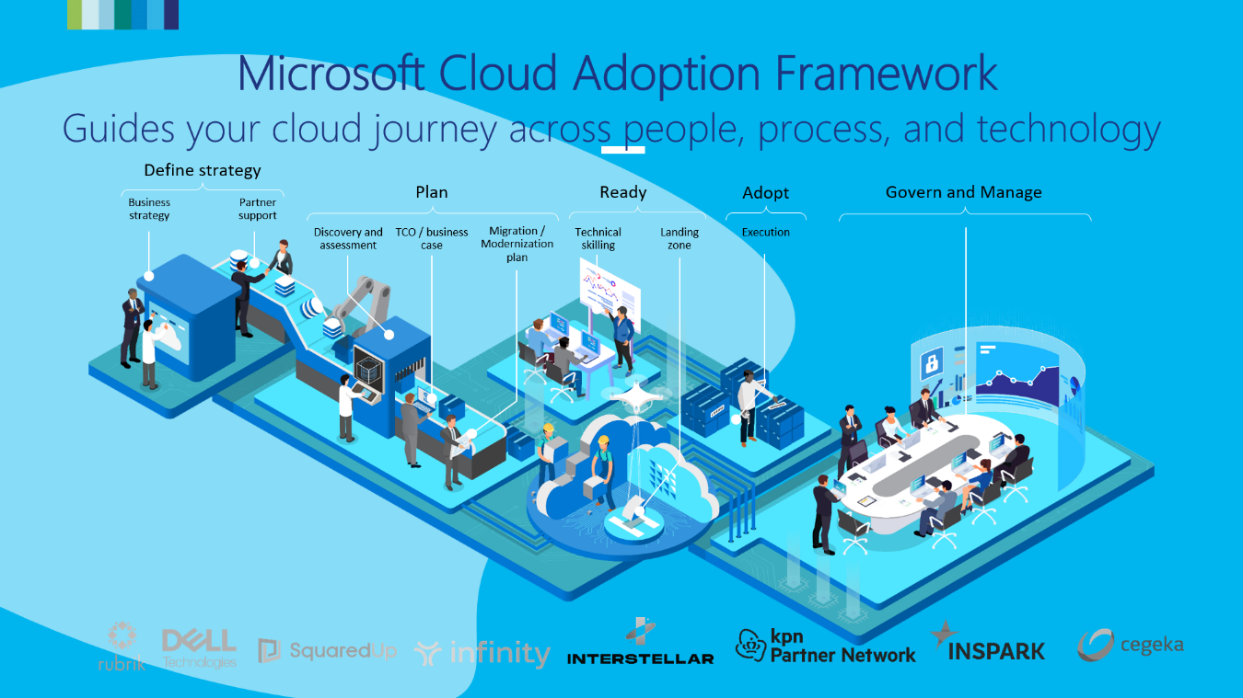

Before we can start

Slide 7
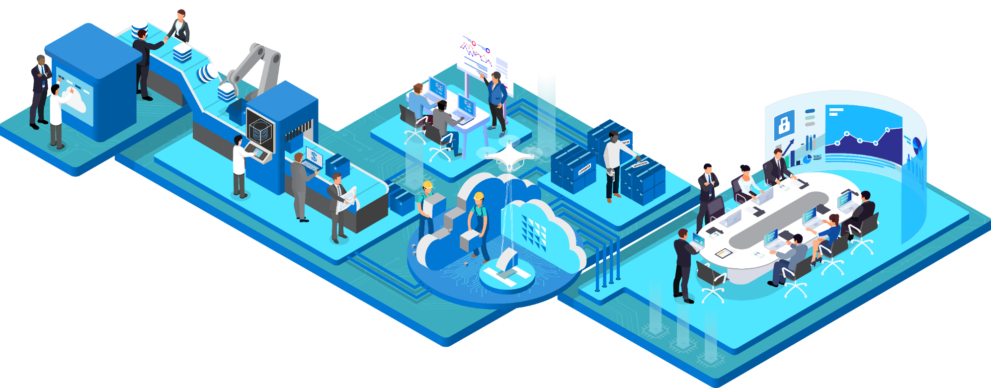
Microsoft Cloud Adoption Framework
Guides your cloud journey across people, process, and technology
Define strategy
Plan
Ready
Adopt
Govern and Manage
Business strategy
Partner support
Discovery and assessment
TCO / business case
Migration / Modernization plan
Technical skilling
Landing
zone
Execution

Slide 8


What are we going to discuss?
People
Process
Technology
Key Takeaways & Actionable steps

Slide 9

People: Building a Security-First Culture
At the heart of any robust security strategy are the people who implement and adhere to it. A security-first culture ensures that every individual in the organization is aware of their role in maintaining security.

Slide 10
People: Building a Security-First Culture
Downplaying
Test environments
Small Customer / tenant
Customer does own management
‘Old School’ values
Lack of knowledge
Technical
Responsibility
Accountability
Used to do things the old way

Slide 11
Process: Implementing Security Processes
Scrutinize new subscriptions
Dashboard Availability
Capture full scope of involved tenants
Security baseline

Slide 12
Process: Implementing Security Processes
Instruction portal
Pilot remediation with 5 customer tenants
Bulk project start
Awareness / Trainings

Slide 13
Technology: Leveraging Advanced Technology
Dashboards
MFA
And for Global Admin / Supscription owners: Phising Resistant MFA!
Conditional Access
Secure Management Ports

Slide 14
Technology: Leveraging Advanced Technology
Cost Management
Budget & Anti Fraud Alerts
Microsoft Azure Policies

Slide 15
Technology: Leveraging Advanced Technology
GitHub - dexmach-csp/azure-csp-securescore: Scanning solution for Microsoft CSP partners to gain insights on the security posture of their linked customers
Dexmach - CSP Secure Score Dashboard - Power BI

Slide 16
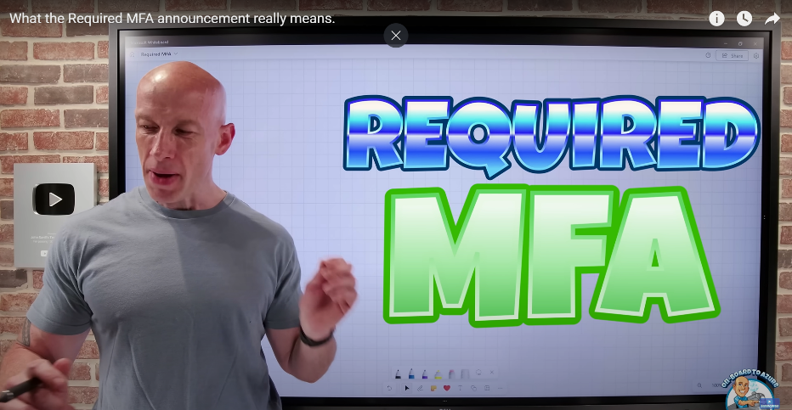
MFA
MFA, MFA, MFA, MFA
MFA
MFA
MFA
MFA

Slide 17
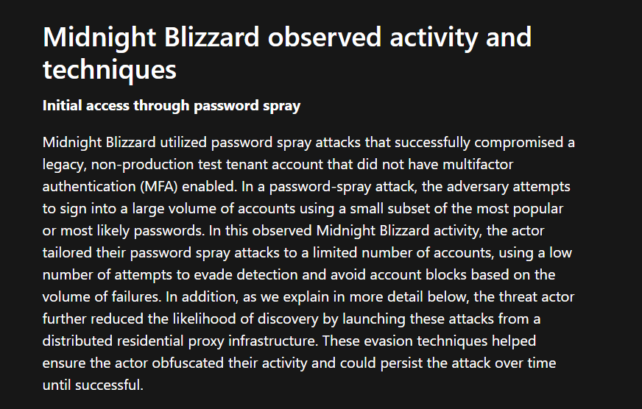
Midnight Blizzard: Guidance for responders on nation-state attack | Microsoft Security Blog

Slide 18
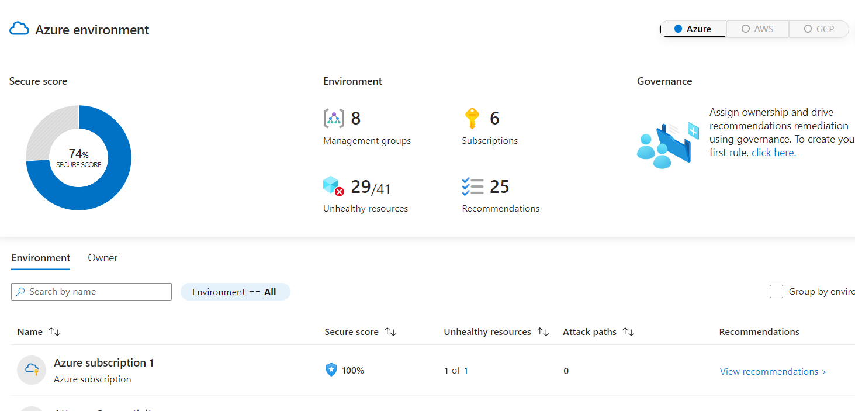
How to see the score? Microsoft Defender for Cloud - Microsoft Azure
Microsoft Defender for Cloud - Microsoft Azure

Slide 19
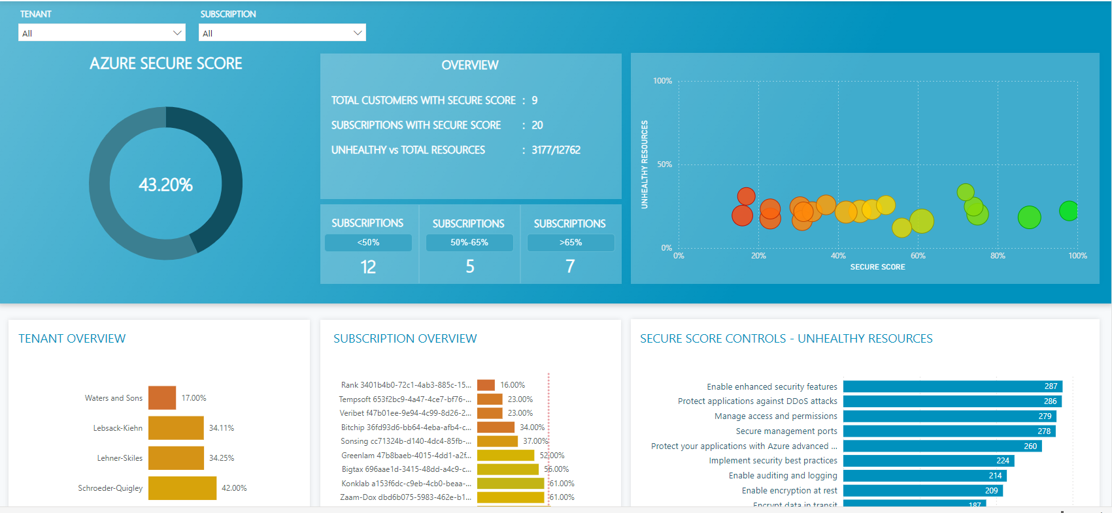
Dashboarding

Slide 20
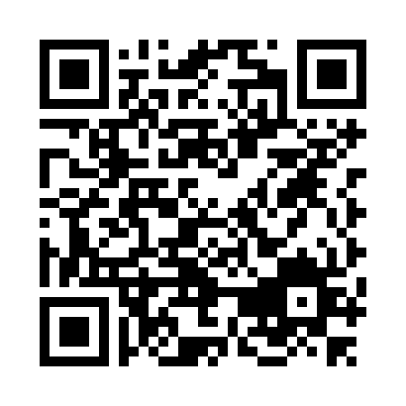
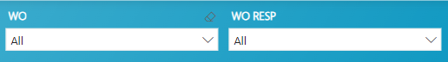
Dashboarding

Slide 21
Securing Azure Subscriptions
MFA, MFA, MFA, MFA.
And for Global Admin / Subscription owners: Phising Resistant MFA!
Microsoft Privilege Identity Management (PIM)
Conditional Access Policies
Cost Management
Budget & Anti Fraud Alerts
Microsoft Azure Policies
http://aka.ms/AzureSecurityStappenplan

Slide 22
Mission 65 Azure Remediation Program

Slide 23






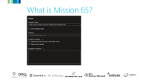
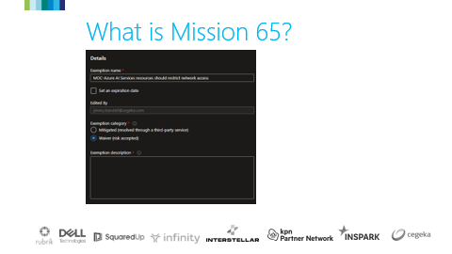
What is Mission 65?
(Azure) Secure
Score of > 65%
High Impact &
Almost Certain Probability
Customers under
the Fabrikam CSP tenant.
Driven by Microsoft to all (CSP) Partners
Azure & Entra ID when
related to Azure Secure
Score from Microsoft

Slide 24
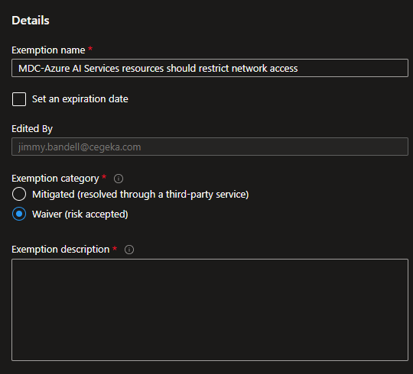
What is Mission 65?

Slide 25
What is Mission 65?
(Azure) Secure
Score of > 65%
High Impact &
Almost Certain Probability
Customers under
the Fabrikam CSP tenant.
Driven by Microsoft to all (CSP) Partners
Azure & Entra ID when
related to Azure Secure
Score from Microsoft

Slide 26
Let’s get started
Finding all Subscriptions
Sponsorship
The right expertise

Slide 27
Call to Action @ Fabrikam
NO MATTER HOW YOU LOOK AT IT, YOU’RE GOING TO HAVE TO DO ONE OF THE FOLLOWING THREE:
Resolve and remediate, because we are responsible and liable
Proposal to customer, if it is not part of the (contracted) services
Have the customer declare (in writing) that he/she is responsible and liable

Slide 28
Key takeaways
Security-first Culture
Training
Roles and responsibility
Security Process
Governance Framework
Security Baseline
Take the low-hanging fruit!

Slide 29
Action Plan
Inventory your subscriptions
Make data transparent
Start your pilot project

Slide 30
